Slide 1
FLOWCHARTS
A lot of Our programs so far consist of just a list of commands to be done in order
  The program cannot choose whether or not to perform a command
  The program cannot perform the same command more than once
  Such programs are extremely limited!
Control structures allow a program to base its behavior on the values of variables

Slide 2
Control structures
Some classes of control structures are:
1. Sequence structure
• Programs executed sequentially by default
2. Selection structures
• eg. if, if/else, switch
3. Repetition structures
• eg. while, do/while, for

Slide 3
Selection Control Structures
Some types of selection statements include:
– if selection statement
– if … else selection statement
– switch selection statements

Slide 4
Selection Control Structures explained
The if selection statement is called a single-selection structure
It selects or ignores a single action (group of actions)
2. The if…else statement is called a double selection structure
It selects between two different action (group of actions)
3. The switch statement is called a multiple-selection structure.
It selects among different actions (group of actions)

Slide 5
Flowchart for the if statement
condition?
If selection structure performs an indicated action only when the condition is true otherwise the action is skipped
true
statement
false

Slide 6
The If Selection Structure
Example: Let’s have pseudocode statement
» If student’s grade is greater than or equal to 60, Print “Passed”
Start
If studentgrade >= 60
Print “Passed”
Stop
Studentgrade>=60
true
Print Passed
false

Slide 7
Exercise on If Selection
Write a program using pseudocode and flow chart that would accept the age of a person.
If age > 18 Display a message indicating you can vote. Else Display a message indicating you can't vote.

Slide 8
The If … else selection structure
The if…else selection structure allows the programmer to specify that different action is to be performed when condition is true and when the condition is false

Slide 9
Flowchart for the if-else statement
condition?
true
false
statement-1
statement-2

Slide 10
The If … else selection structure
The if…else selection structure allows the programmer to specify that different action is to be performed when condition is true and when the condition is false
For example: If a student’s grade is greater than or equal to 60, print passed else print failed
Studentgrade>=60
true
false
Print Passed
Print failed

Slide 11
Nested if …else Statement
Nested if…else structure test for multiple cases by placing if…else selection structures inside if…else selection structure
if (grade >= 70)
Print A
else if (grade >= 60)
Print B
else if (grade >= 50)
Print C
else if (grade >= 40)
Print D
else
Print F

Slide 12
Repetition Control Structures

Slide 13
Repetition Control Structures
repetition structures are created with repetition statement(s)
Examples of repetition statements are:
  – while
  – do…while
  – For

Slide 14
While loop
A WHILE loop is a loop that repeats while some condition is satisfied.
•The WHILE loop tests its condition at the beginning of every loop.
•If the condition is false from the start, the sequence of activities contained in the loop never runs at all.

Slide 15
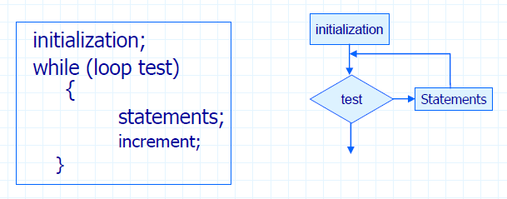
While Control Structure (Loop)
A while repetition structure allows the programmer to specify that an action is to be repeated while some condition remains true.

Slide 16
The while loop
This is the form of the while loop:
while (condition) statement(s)
If the condition is true, the statement is executed, then the whole thing is done again
The statement is executed repeatedly until the condition becomes false
If the condition starts out false, the statement is never executed at all

Slide 17
Flowchart for the while loop
condition?
true
statement
false

Slide 18
Exercise: Write a program using a while loop that prints “I love computers” five (5) times
Exercise: Write the complete flowchart for this algorithm
Pseudocode
Start
2. count = 0
3. While count < 5
Display "I love computers!"
4. Increment count
5. Endwhile
6. Stop

Slide 19
Exercise
1. Write a computer solution in pseudocode and flowchart print the numbers 1 to 5 using while loop.
2. Write a computer solution in pseudocode and flowchart to calculate the average of “N” students using the while loop

Slide 20
Do…While Control Structure (Loop)
Like a while loop, a do-while loop is a loop that repeats while some condition is satisfied.
•Unlike a while loop, a do-while loop tests its condition at the end of the loop.
•This means that its sequence of activities always runs at least once.

Slide 21
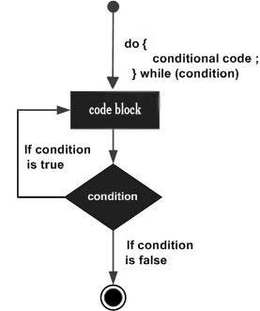
The Do While Control Structure
A do...while loop is similar to a while loop, except the fact that it is guaranteed to execute at least one time.
The syntax of a do...while loop in C programming language is
do
{ statement(s); }
while( condition );

Slide 22
The Do While Control Structure
In case the condition is true, the control goes back to the beginning of the loop.
If the condition is false, the control breaks out of the loop.
This means that the statements inside the loop are executed before the condition is tested.
So the do while loop should be used in all scenarios where the loop body needs to be executed at least once

Slide 23
Do ….While Example
An algorithm in pseudocode to print
Hello World two times.
using do .. while
Start
i = 2
Do
  Print “Hello World”
  Increase i by 1
While i<1
EndWhile
End
Dry run of the program
Program starts.
. i is initialised to 2.
Execution enters the do loop
a) "Hello World" gets printed 1st time.
b) Update is done. (i is increased by 1)
Now i = 2.
4. Condition is checked.
2 < 2 yields false. 5.
5. The flow goes outside the loop.
The output of this program will be: Hello World

Slide 24
The Do While Control Structure: Example
Write a program in pseudocode and flowchart to add numbers until a user enters the number zero. Use do … while loop

Slide 25
For Loop
A FOR loop is a loop that repeats a specified number of times.
•The loop uses a counter to tell it how many times to run the same sequence of activities

Slide 26
For Loop
The counter has the following three numeric values:
Initial counter value
Increment(the amount to add to the counter each time the loop runs)
Final counter value
•The loop ends when the counter reaches the final counter value, or, if there is an associated test condition, when the test condition is true.

Slide 27
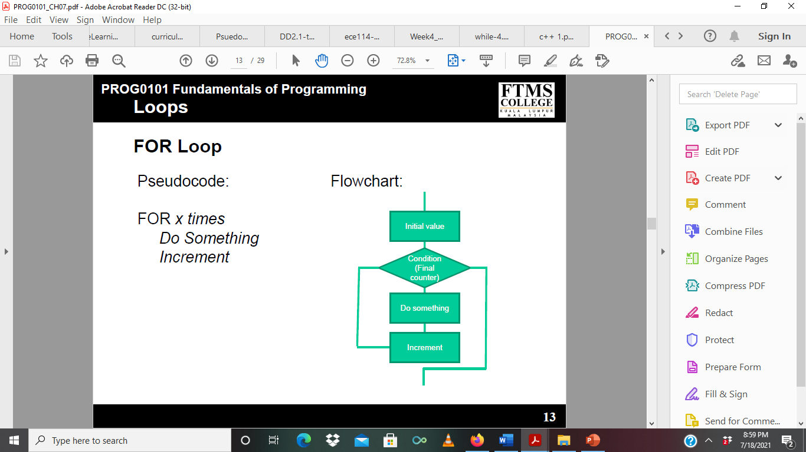
For Loop : Flow chart

Slide 28
For Loop: Pseudocode Example 1
Write a program in pseudocode and flowchart to Find Sum of Natural Numbers (1 to 100).
 | (Pseudocode For Loop Example) BEGIN counter, sum=0 FOR counter=1 TO 100 STEP 1 DO sum=sum+counter ENDFOR OUTPUT sum END
Draw the flow chart

Slide 29
For Loop: Pseudocode Example 2
Write a program in pseudocode and flowchart to Read 50 numbers and find their sum and average. )
 | (Pseudocode For Loop Example BEGIN NUMBER counter, sum=0, num FOR counter=1 TO 50 STEP 1 DO OUTPUT "Enter a Number" INPUT num sum=sum+num ENDFOR OUTPUT sum END
Draw the flow chart

Slide 30
For Loop: Pseudocode Example 3
Write a program in pseudocode and flowchart to Print Numbers from 1 to n.
 | (Pseudocode For Loop ) BEGIN NUMBER counter,n INPUT n FOR counter = 1 TO n STEP 1 DO OUTPUT counter ENDFOR END
Draw the flow chart

Slide 31
Exercises
1. Write a program in pseudocode and flow chart to Read 10 numbers and find sum of even numbers. Tip: Use the modulus symbol
2. Write a program in pseudocode and flow chart to Calculate the Sum and Average of n Number

Slide 32
3. Design the algorithm and flowchart that finds and display the larger of the two numbers given different from each other.
4. The voltage (V) between the poles of a conductor is equal to the product of the current (I) passing through the conductor and the resistance (R) present on the conductor. It’s demonstrated by the V = I * R formula. Write an algorithm using pseudocode and flowcharts to calculate the voltage between the poles of the conductor by using the formula according to the current and resistance values entered by the user.

